Slide 1
CES 361
Fundamentals of Software Testing
Session 6

Slide 2
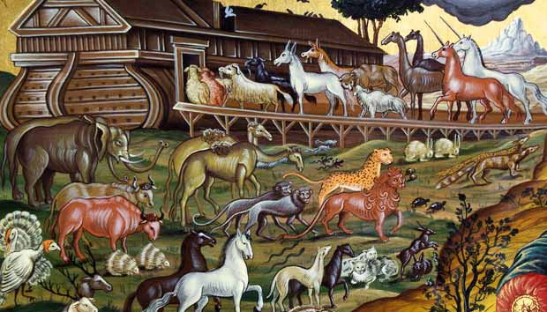
Math Function Program
A program has four input variables:
w, x, y, z
2. Each variable can take on one of three values:
0, 1, 2
3. What is the size of the input space?
4. Assume “test budget” only allows
for 10 test cases of this function in
the regression test.
5. What is a smart way to write this test plan?
Case | w | x | y | z
1
2
3
4
5
6
7
8
9
10
eo
STOP
What’s another way
to ask that question?
STOP
What’s a regression test?
GO
STOP
STOP
Was this hard?
What was your strategy?
Why is it missing?
This is new...
What’s missing?
Let’s discuss now
Get to work... .

Slide 3
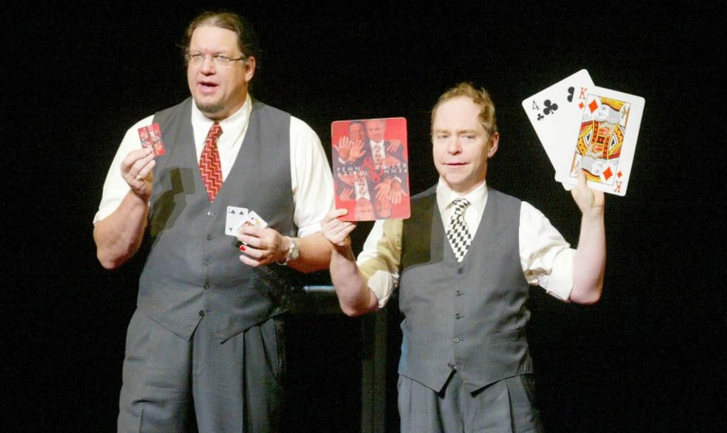
My Answer
w | x | C
0 | 0 | 1
0 | 1 | 2
0 | 2 | 3
1 | 0 | 4
1 | 1 | 5
1 | 2 | 6
2 | 0 | 7
2 | 1 | 8
2 | 2 | 9
w | y | C
0 | 0 | 1
0 | 1 | 2
0 | 2 | 3
1 | 0 | 6
1 | 1 | 4
1 | 2 | 5
2 | 0 | 8
2 | 1 | 9
2 | 2 | 7
w | z | C
0 | 0 | 1
0 | 1 | 2
0 | 2 | 0
1 | 0 | 5
1 | 1 | 6
1 | 2 | 4
2 | 0 | 9
2 | 1 | 7
2 | 2 | 8
x | y | C
0 | 0 | 1
0 | 1 | 4
0 | 2 | 7
1 | 0 | 8
1 | 1 | 2
1 | 2 | 5
2 | 0 | 6
2 | 1 | 9
2 | 2 | 3
y | z | C
0 | 0 | 1
0 | 1 | 6
0 | 2 | 8
1 | 0 | 9
1 | 1 | 2
1 | 2 | 4
2 | 0 | 5
2 | 1 | 7
2 | 2 | 3
Case | w | x | y | z
1 | 0 | 0 | 0 | 0
2 | 0 | 1 | 1 | 1
3 | 0 | 2 | 2 | 2
4 | 1 | 0 | 1 | 2
5 | 1 | 1 | 2 | 0
6 | 1 | 2 | 0 | 1
7 | 2 | 0 | 2 | 1
8 | 2 | 1 | 0 | 2
9 | 2 | 2 | 1 | 0
10
This is an orthogonal array
4 variables, 3 values each, strength of 2
(S=2 ⇒ Test all pairwise combinations)
Translation: for every pair of variables,
what is the size of the input space?

Slide 4
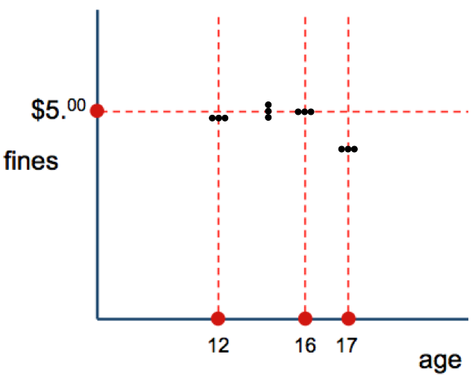
The Magic of Orthogonal Array Testing
0000000
1111110
2222220
0012120
1120200
2201010
0102211
1210021
2021101
0220111
1001221
2112001
0121022
1202102
2010212
0211202
1022012
2100122
Remarkably scalable:
  4 vars, 3 values each: 81 vs. 9
  7 vars, 3 values each: 2187 vs. ?
  13 vars, 3 values each: 1.5 million vs. ?
  21 vars, 4 values each:
  9 vars, 2 values, strength of 5: 128 cases
  16 vars, 2 values, strength of 5: 256 cases
    Δ 2⁹ & 2¹⁶ = 512 & 65,536 (∴ ¹/₄ & ¹/₂₅₆)
But: Is “3 possible values” realistic?
Tools exist to generate orthogonal arrays
as well as orthogonal array-based test cases
  try www.pairwise.org/tools.asp for starters
18 (see right)
27
STOP
4²¹ (4.3 trillion) vs. 64
What did we talk
about last week?
That’s where I found:
http://alarcosj.esi.uclm.es/CombTestWeb/combinatorial.jsp

Slide 5
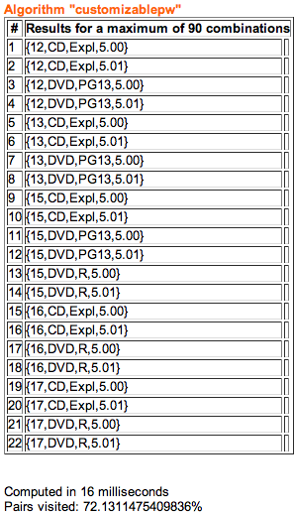
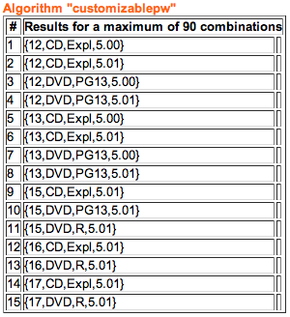
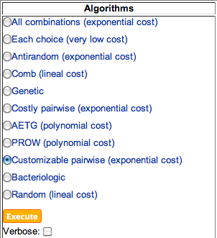
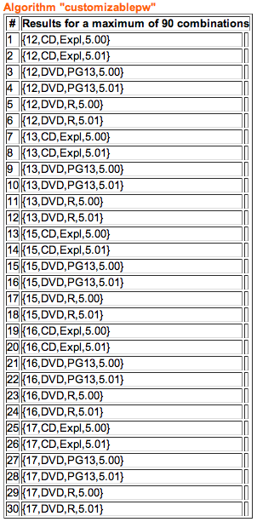
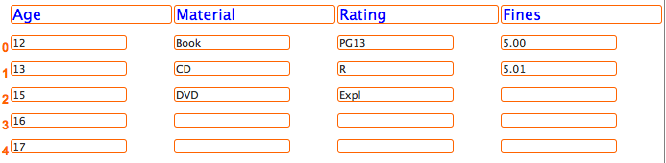
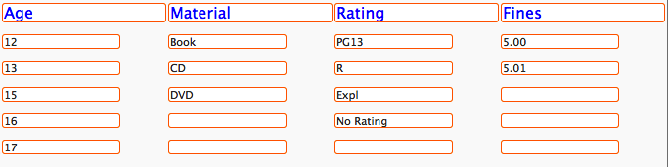
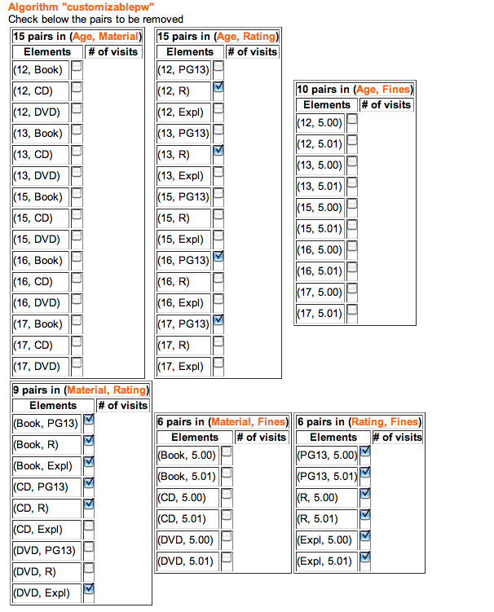
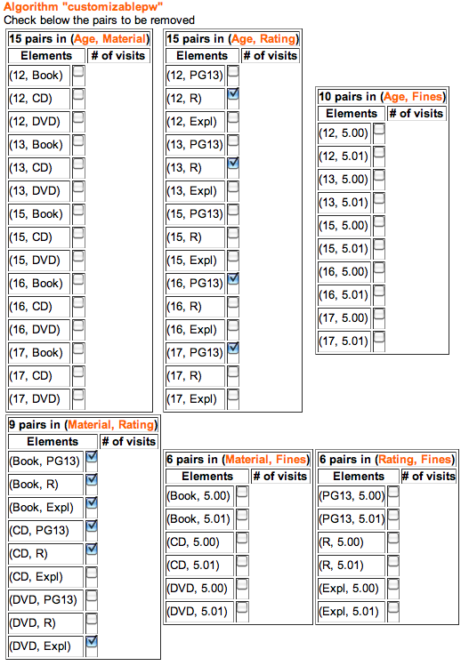
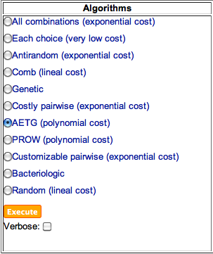
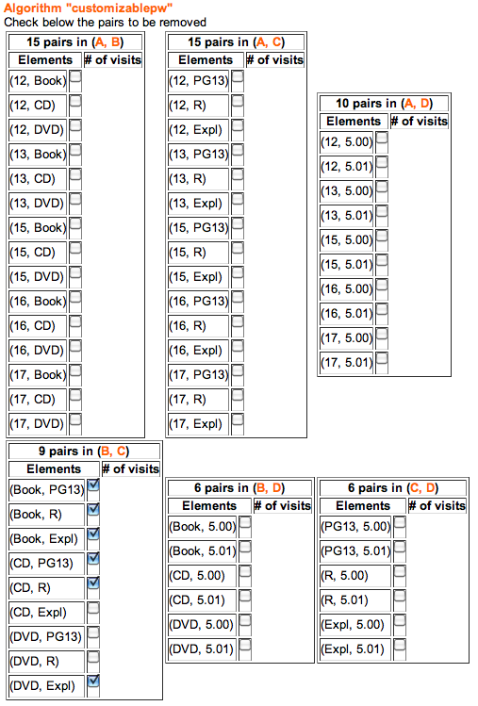
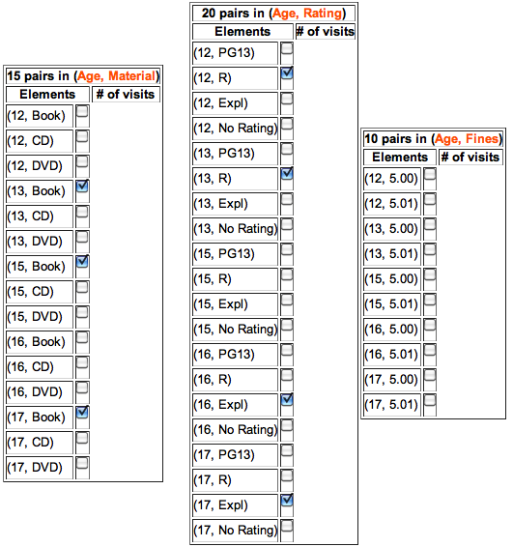
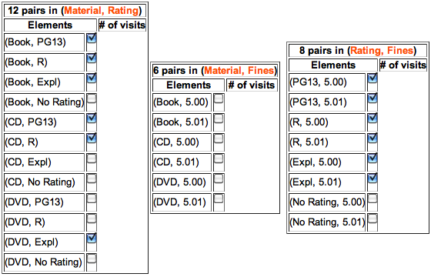
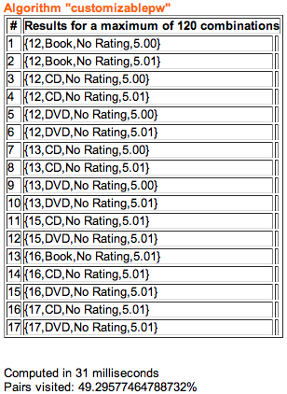
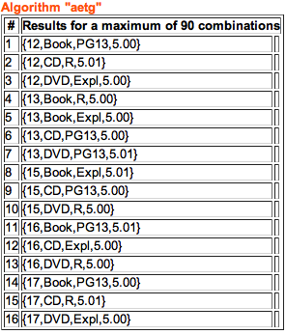
QUESTION:
What’s wrong with this test set?
QUESTION:
Does anyone want to see what happened?

Slide 6
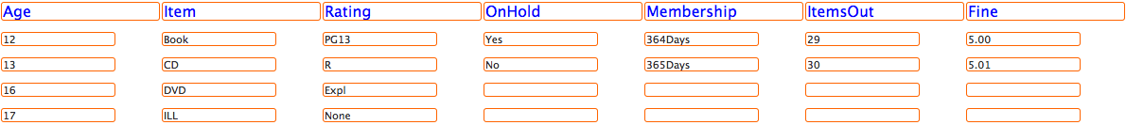
Library Checkout Requirements
The library has three types of materials:
Books, Movies (DVDs), Music (CDs)
2. Patrons with accumulated fines of over $5
may not check out any more materials
3. Patrons under 13 may only check out G-rated DVDs
Patrons under 17 may not check out R-rated DVDs
Patrons under 16 may not check out Explicit CDs
4. Patrons may not check out items that have a
hold request by another customer
5. Patrons may not check out more than 30 items
at any one time
6. Patrons may not check out Interlibrary Loan
materials from outside the county until they have
been a member in good standing for at least 1 year

Slide 7
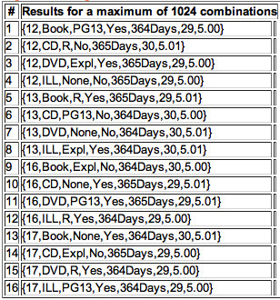
Case: Patron at age 12... | #
checking out Book | 1
checking out CD | 2
checking out DVD | 3
checking out ILL | 4
checking out PG-13 material | 1
checking out R-rated material | 2
checking out explicit material | 3
checking out non-rated material | 4
checking out item on hold | 1
checking out item not on hold | 2
with membership < 1 year | 1
with membership ≥ 1 year | 2
with 29 items checked out | 1
with 30 items checked out | 2
with $5 fine | 1
with more than $5 fine | 1
Case: Patron with DVD | #
at age 12 | 3
at age 13 | 7
at age 16 | 11
at age 17 | 15
rated PG-13 | 11
rated R | 15
Explicit* | 3
with no rating | 7
which is on hold | 3
which is not on hold | 7
with membership < 1 year | 7
with membership ≥ 1 year | 3
with 29 items checked out | 3
with 30 items checked out | 7
with $5 fine | 3
with more than $5 fine | 11
Library Checkout Requirements
The library has three types of materials:
Books, Movies (DVDs), Music (CDs)
2. Patrons with accumulated fines of over $5
may not check out any more materials
3. Patrons under 13 may only check out G-rated DVDs
Patrons under 17 may not check out R-rated DVDs
Patrons under 16 may not check out Explicit CDs
4. Patrons may not check out items that have a
hold request by another customer
5. Patrons may not check out more than 30 items
at any one time
6. Patrons may not check out Interlibrary Loan
materials from outside the county until they have
been a member in good standing for at least 1 year
*What do we do about this case?
Questions or Comments?

Slide 8
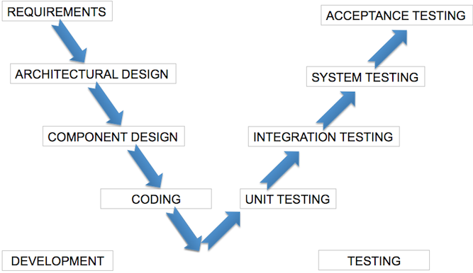

Summary
Orthogonal arrays are a powerful, scalable tool
Value of technique demonstrated in industry
You may need to tinker with resulting test suite
Where can this be applied in the V-model?

Slide 9
For further reading
REQUIRED
see https://inductive.no/pairwiser/knowledge-base/introduction-to-pairwise-testing/
(read the overview, and look over the two examples)
RECOMMENDED
see http://burtleburtle.net/bob/math/jenny.html
(read about the development of a pairwise tester,
and about the use of that program to test itself)
  VISIT www.pairwise.org/tools.asp and find a tool you like
  I used http://alarcosj.esi.uclm.es/CombTestWeb/combinatorial.jsp
(your next assignment will require an orthogonal array)
Links will be posted on Pilot

Slide 10
This slide intentionally left blank

